Slide 1



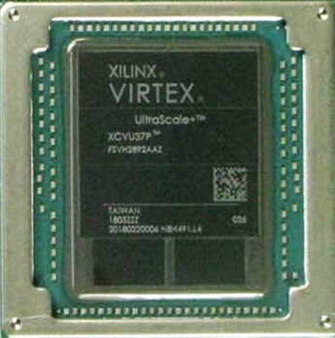
Hierarchical Interconnect Address Event Routing for
Large-Scale Neuromorphic Cognitive Computing
https://www.nsf.gov/awardsearch/showAward?AWD_ID=1823366
HiAER-Spike
Omowuyi Olajide presenting for UCSD HiAER-Spike
June 29, 2023
"Reverse Engineering the Cognitive Brain"; G. Cauwenberghs, Proc. Nat. Acad. Sci. (PNAS), vol. 110 (39), pp. 15512-15513, 2013.

Slide 2
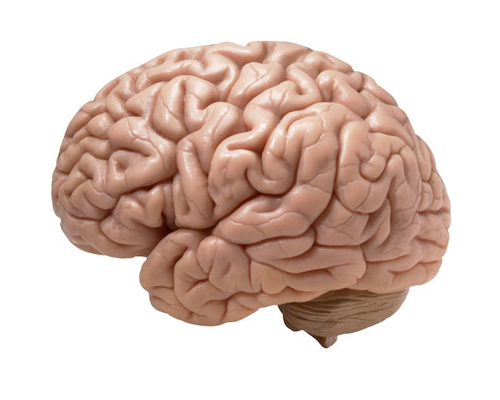
The Challenge: Capture Neural Dynamics in Silicon
for Real Time Emulation at Scale
To inspire new models for Brain Dynamics and Machine Learning
CRI FireFly Interconnect Option
https://www.nsf.gov/awardsearch/showAward?WD_ID=1823366

Slide 3
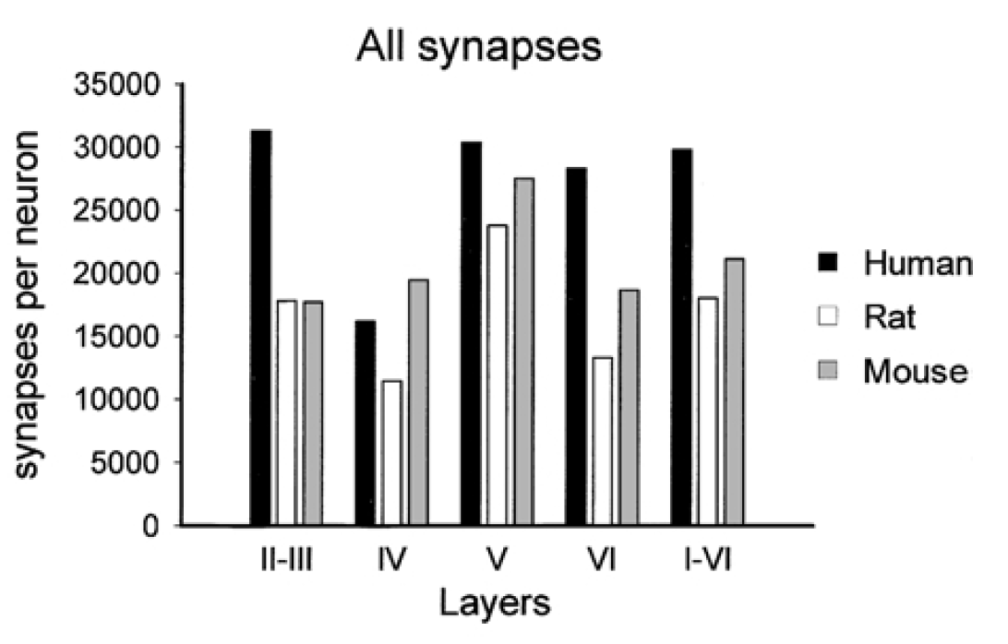
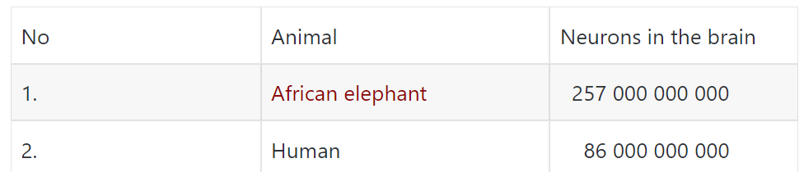
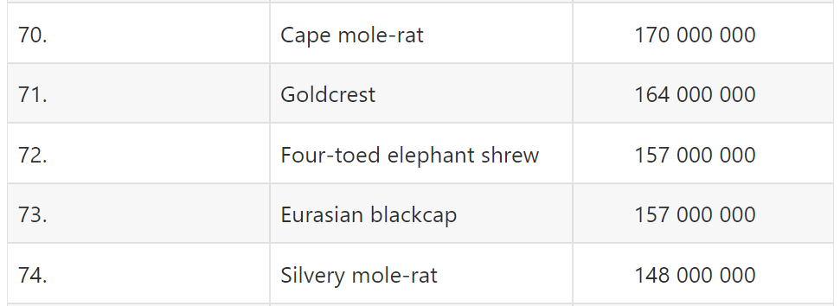
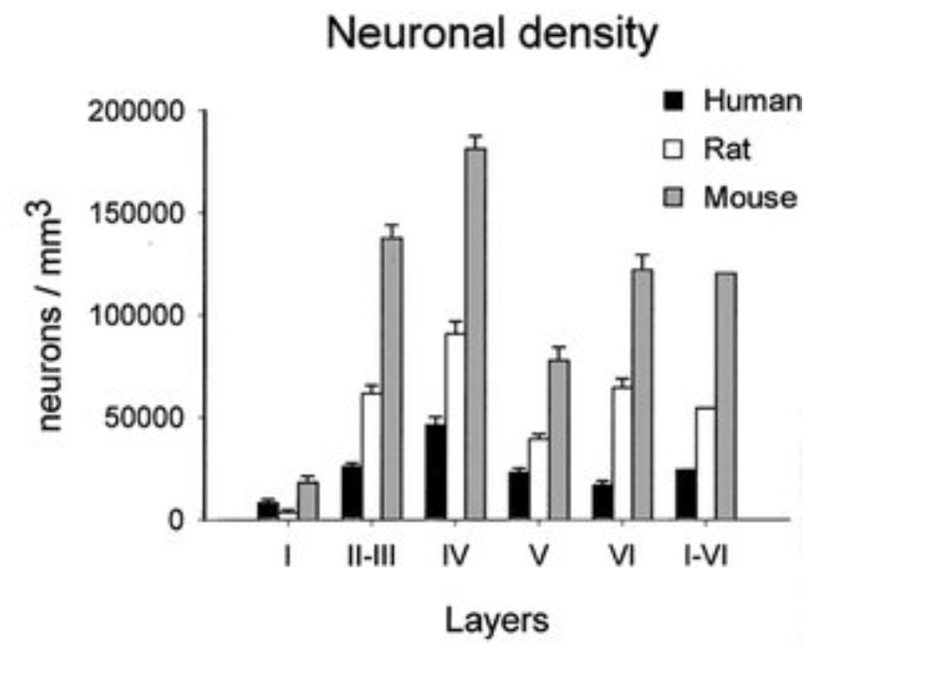
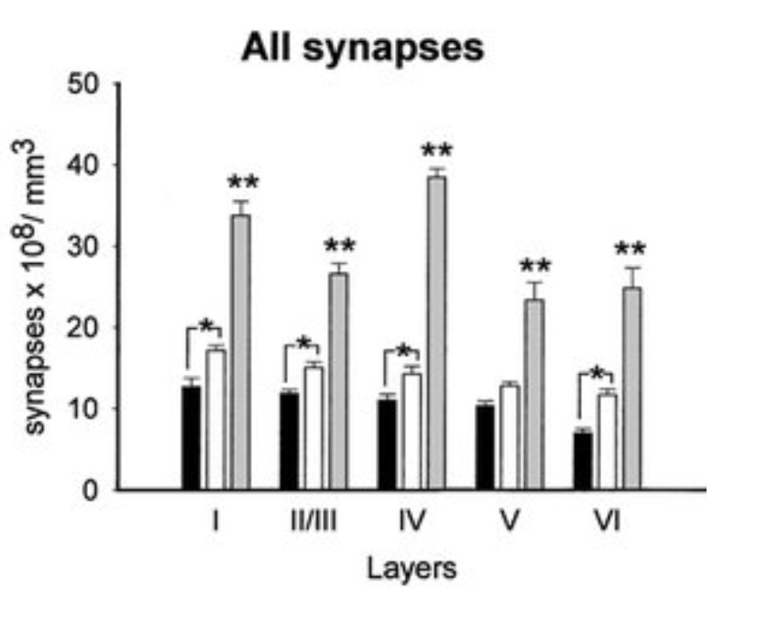
160M neurons and 40G Synapses
.
.
.
.
.
.
https://dinoanimals.com/animals/number-of-neurons-in-the-brain-of-animals/
Microstructure of the neocortex: Comparative aspects
Jon Arellano et al, Journal of Neurocytology · March 2002

Slide 4
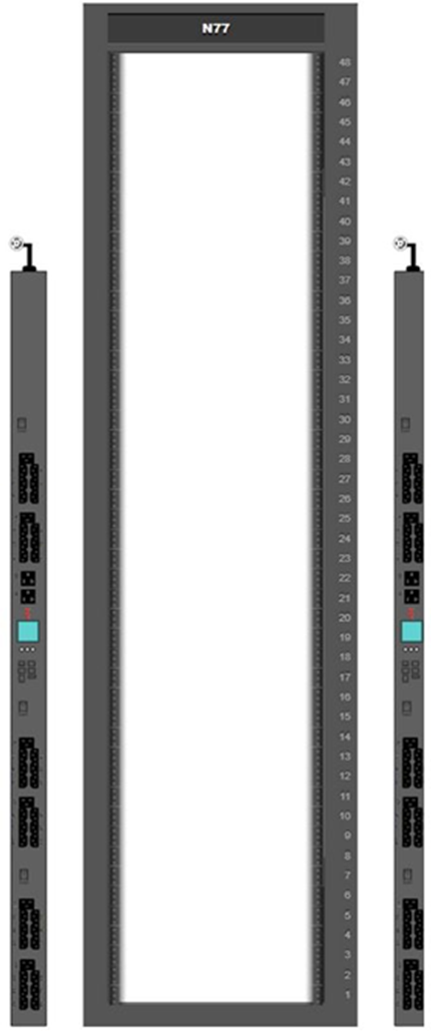
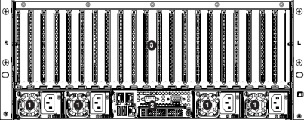
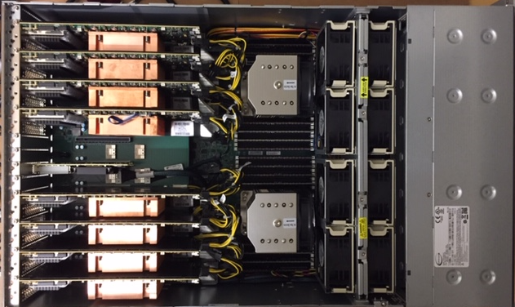
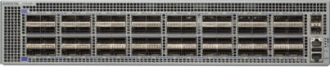
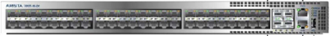
CRI Rack
1 SERVER
O77
unused space
Space for
Neurodyn
shelves
0
Server ‘0’ for
development
(add later)
1
EPYC 7502
32 core ea
All in-rack cables
are DAC 100G, SFP
or RJ45. Ext Conn.
to be determined
2
Arista
DCS-7170-64C-R
DCS-7050CX3-32SP-R
DCS-7010T-48-R
3
Servers are
SMC EPYC
AS-4124GS-TNR
1 Server of
5 for NSG
8 FPGAs
4
Server lid extension
for internal cables
5
8 ADM-PCIE-9H7
13 port USB 3.1

Slide 5
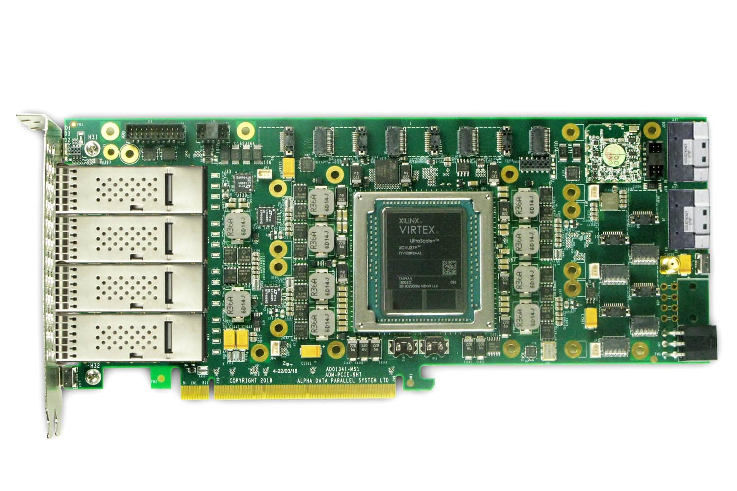
Alpha-Data ADM-PCIE-9H7
8 Firefly ports, 4 QSFP, 2 Slim SAS, PCIex16
4 QSFP28s, 8 Fireflys*, each 4 bidi lanes x 28Gbps/lane/dir (or 14, 16, 25 Gbps), 2 Slim SAS 100Gbps
* https://www.samtec.com/optics/optical-cable/mid-board/firefly
5

Slide 6
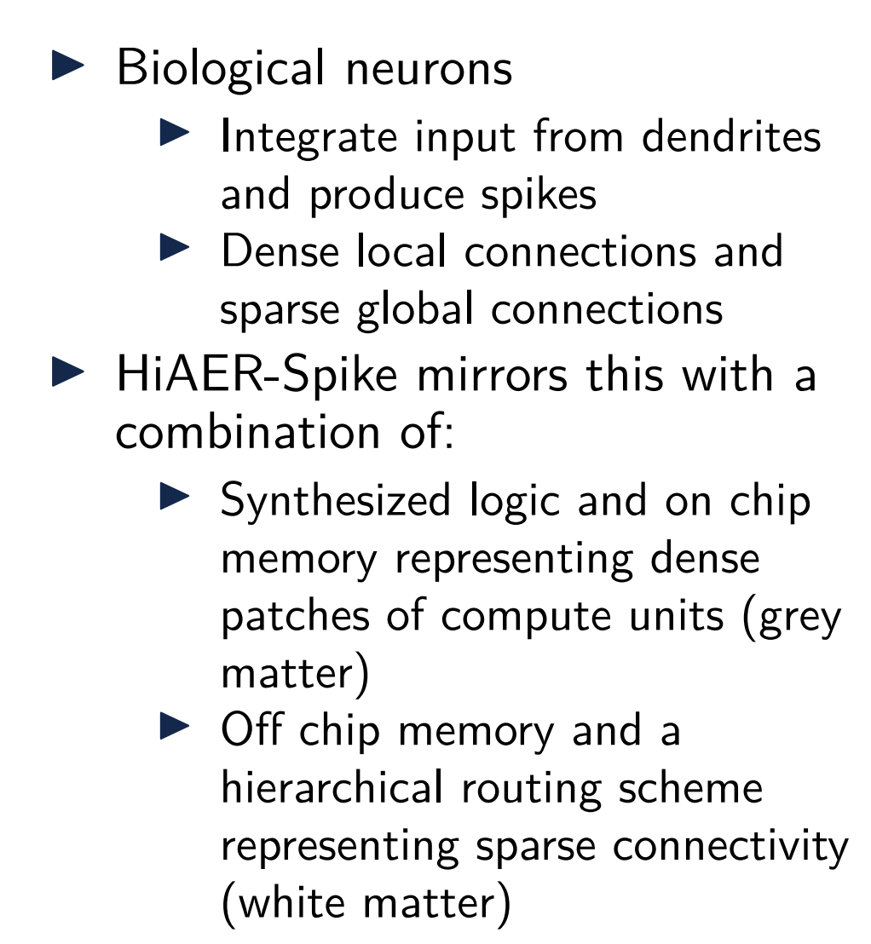
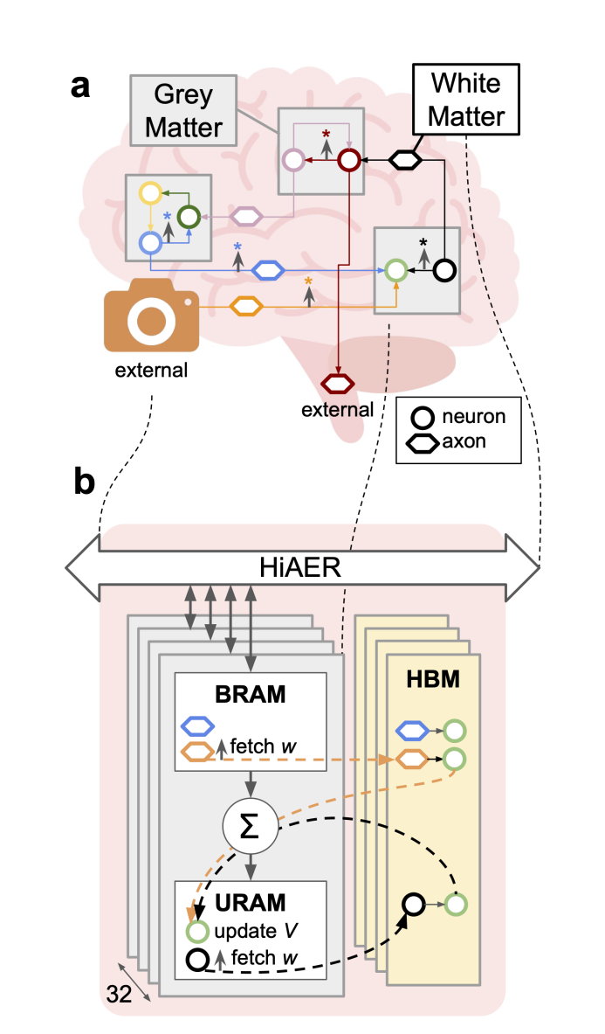
HBM–centric processing architecture

Slide 7
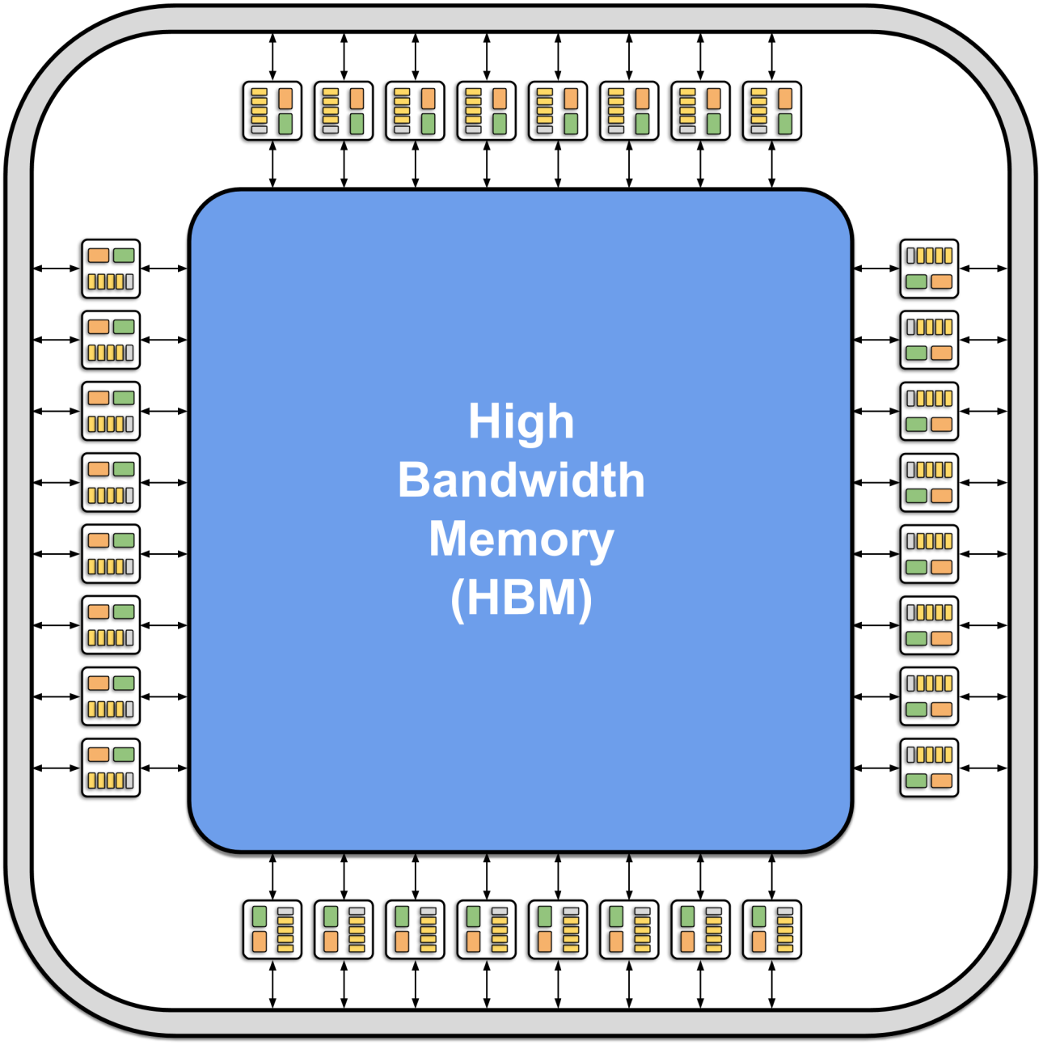
HBM–centric processing architecture
Processors
32 HBM AXI interfaces → 32 parallel processor cores
Neurons
4M neurons / 32 processors = 128K neurons / core
Synaptic Weight & Route Table memory
8 GB total HBM memory:
8 GB / 32 cores= 256 MB / core
256 MB / 32b = 64MB pointers and weights
64MB / 128K neurons = 512 pointers-weights/neuron
Neuron memory
960 URAM blocks:
960 blocks / 32 cores= 30 blocks / core
30 blocks = 120K × 72 bits = 8.64 Mb / core
8.64 Mb / 128K neurons = 67 bits / neuron
Routing memory (for off-core events)
BRAM used for FIFOs

Slide 8
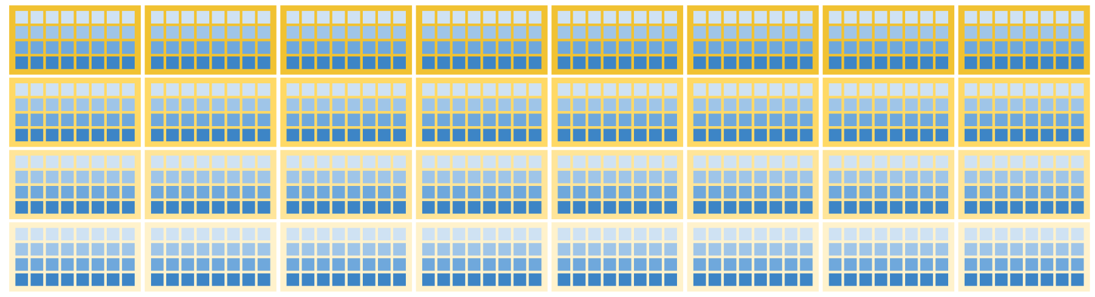
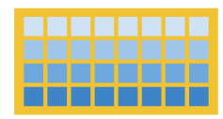
System organization
4 FPGA clusters, with 4 core clusters per FPGA
FPGA 0
FPGA 1
FPGA 2
FPGA 3
FPGA 4
FPGA 5
FPGA 6
FPGA 7
fpga cluster 0 →
fpga cluster 1 →
fpga cluster 2 →
fpga cluster 3 →
core 0
core 1
core 2
core 3
core 4
core 5
core 6
core 7
core cluster 0 →
core cluster 1 →
core cluster 2 →
core cluster 3 →
single FPGA

Slide 9
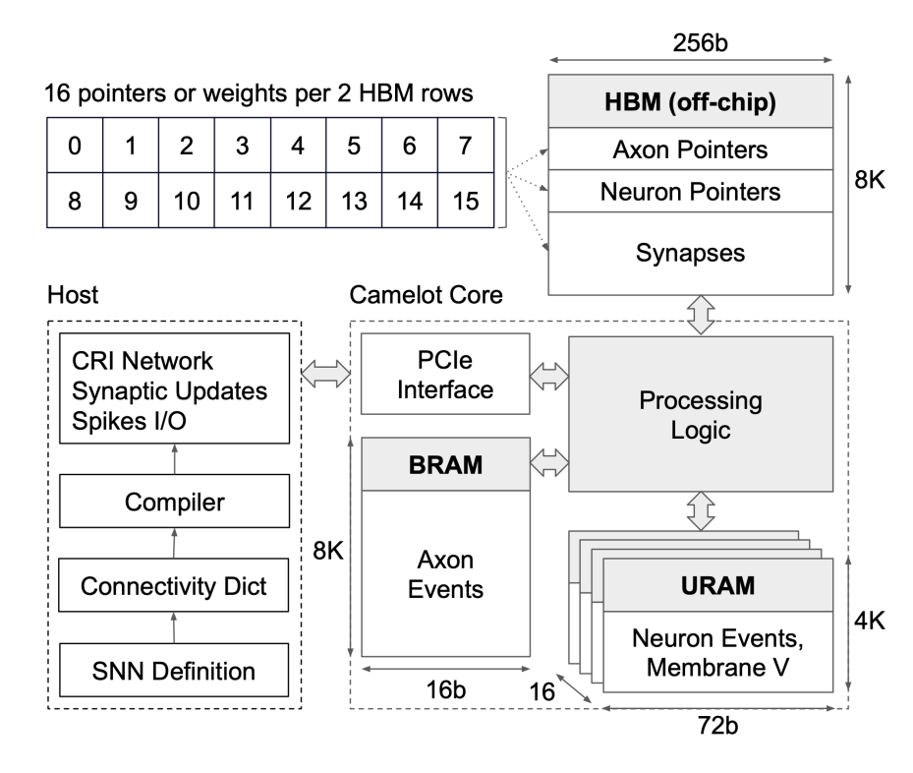
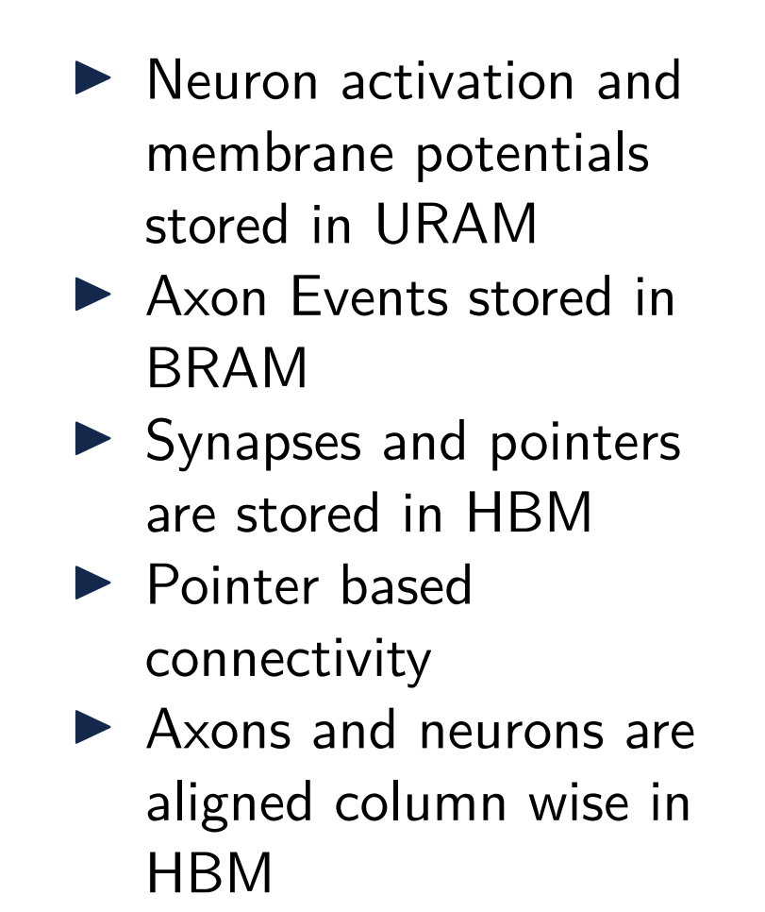
Core architecture Overview

Slide 10
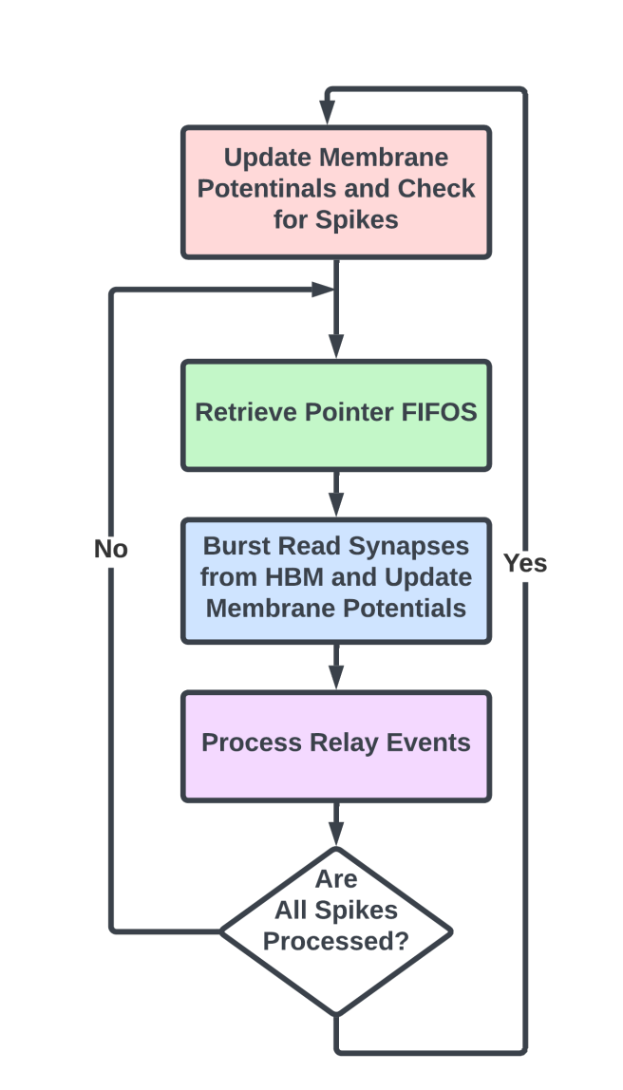
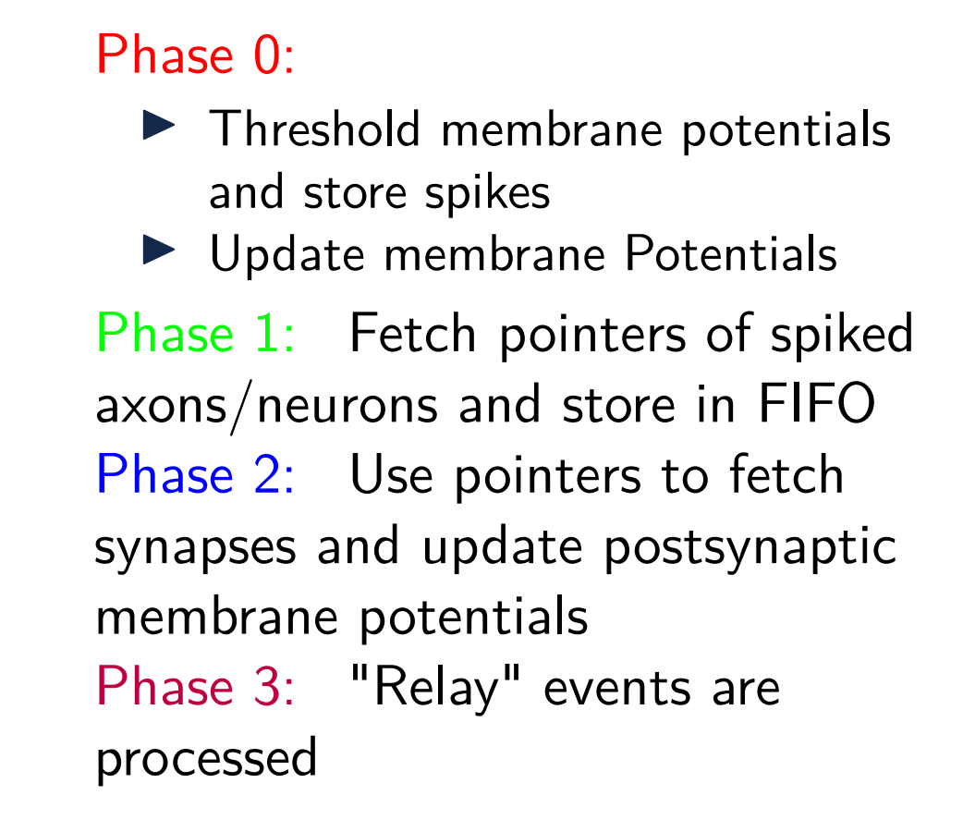
Core processing Overview

Slide 11
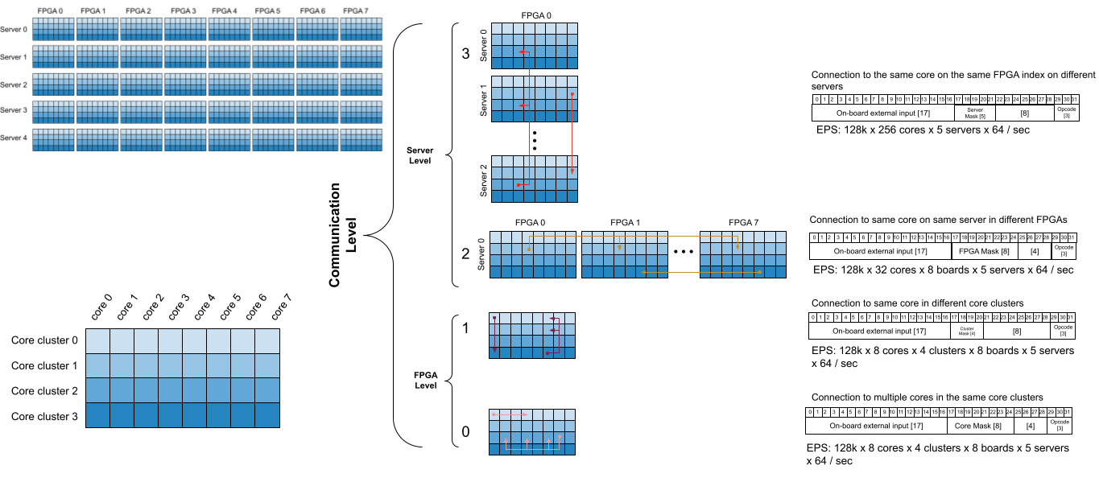
Hierarchical Routing
"Hierarchical Address Event Routing for Reconfigurable Large-Scale Neuromorphic Systems," J. Park, T. Yu, S. Joshi, C. Maier and G. Cauwenberghs, in IEEE Transactions on Neural Networks and Learning Systems, vol. 28, no. 10, pp. 2408-2422, Oct. 2017
"Scalable Event Routing in Hierarchical Neural Array Architecture with Global Synaptic Connectivity," S. Joshi, S. Deiss, M. Arnold, J. Park, T. Yu, and G. Cauwenberghs, Proc. IEEE Int. Workshop Cellular Nanoscale Networks and Their Applications (CNNA 2010), Berkeley CA, Febr. 3-5, 2010.

Slide 12

Hierarchical Core Packet Communication
$$C_{Core−Cluster−FPGA−Server}$$

Slide 13
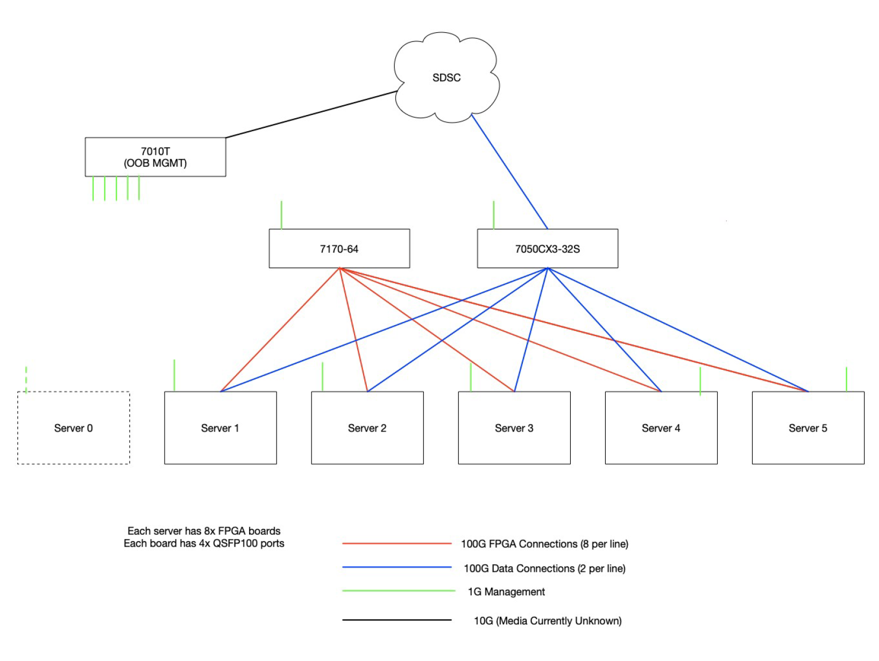
Switch Utilization
NSG
1Gbps Ethernet (IPMI)
NSG Interface
SLURM Job Control
File Sharing Control
Network Compilation
Network Partitioning
Network Mapping
SW & FW Tests
P4 Programmable 100Gbps
100Gig Ethernet
Spike Processing
File Sharing
Server 0
Server 1
Server 2
Server 3
Server 4
Server 5
25 TB SSD
25 TB SSD
25 TB SSD
25 TB SSD
25 TB SSD
25 TB SSD
5 servers have 8 FPGA Boards each.
The 6th is for system & job control.
(2 per line)

Slide 14
Thank you

